Slide 1




Operating System principle
2019-2020-2

Slide 2

Part3 processor scheduling and deadlock
3.1 Processor scheduling level and objective of scheduling algorithm
3.2 Job and job scheduling
3.3 Process scheduling
3.4 Realtime scheduling
3.5 Deadlock overview
3.6 Deadlock avoidance

Slide 3
3.1 Processor scheduling level and objective of scheduling algorithm
In multiprogramming system, the essence of scheduling is resource allocation, and processor scheduling is resource allocation to processor. Processor scheduling algorithm refers to the processor allocation algorithm specified according to the processor allocation policy. In a multi-channel batch system, a job may need to go through multilevel processor scheduling from submission to acquisition processor execution until the job runs out.

Slide 4
3.1.1 Processor scheduling level
1. High Level Scheduling
High level scheduling, also known as long range scheduling or job scheduling, its scheduling object is the job. Its main function is to determine, by some algorithm, which jobs stored on the external standby queue are called into memory, create processes for them, allocate the necessary resources, and put them on the ready queue. High level scheduling is mainly used in multi-channel batch processing systems, but not in time-sharing and real-time systems.

Slide 5
2. Low Level Scheduling
Low-level scheduling, also known as process scheduling or short-range scheduling, its scheduling object is the process (or kernel-level threads). Its main function is to determine, based on an algorithm, which process in the ready queue should get the processor, and the dispatcher assigns the processor to the selected process. Process scheduling is the most basic type of scheduling that must be configured in multi-channel batch, time-sharing, and real-time OS.

Slide 6
3. Intermediate Scheduling
Intermediate scheduling is also known as memory scheduling. The main purpose of introducing intermediate scheduling is to improve memory utilization and system throughput. For this reason, processes that are temporarily inactive are put on external storage to wait, the state of the process is called ready to be stored on external storage (or suspended). When they are ready to run and the memory is slightly free, the intermediate scheduling determines that those ready processes that are ready to run on the external storage will be called back into memory, and their state will be changed to ready state, and hang on the ready queue to wait.

Slide 7
In the above three kinds of scheduling, the process scheduling runs most frequently. In the time-sharing system, the process scheduling is usually carried out once in 10-100 ms, so it is called short-range scheduling. In order to avoid the scheduling itself takes up too much CPU time, the process scheduling algorithm should not be too complex. Job scheduling usually occurs when a batch of jobs have finished running and exit the system, and a batch of jobs need to be transferred back into the memory, the cycle of job scheduling is long, about a few minutes, so it is called long range scheduling. Because of its low running frequency, the job scheduling algorithm is allowed to spend more time. The intermediate scheduling runs roughly between the two schedules, so it is called mid-range.

Slide 8
3.1.2 Objective of Processor scheduling algorithm
1. Common goal of processor scheduling algorithms
(1) Resource utilization；In order to improve the system's resource utilization, the processor and all other resources in the system should be kept as busy as possible. The most important processor utilization can be calculated as follows:

Slide 9
(2) fairness. Fairness means that all processes should get reasonable CPU time and process hunger will not occur. Fairness is relative, to the same type of process should get the same service; However, different services should be provided for different types of processes, depending on their urgency or importance.
(3) balance. Because there can be many types of processes in the system, some are computational jobs and some are I/O. In order to make the CPU and various external devices in the system always busy, the scheduling algorithm should keep the balance of system resources as much as possible.
(4) policy enforcement. The policies developed, including security policies, must be implemented accurately as long as they are needed, even if they cause delays in some work.

Slide 10
2. The target of a batch system
(1) The average turnaround time is short。
Turnaround time refers to the time between when the job is submitted to the system and when the job is completed (called job turnaround time). It consists of four parts: the time the job waits on the external storage standby queue (job) for scheduling, the time the process waits on the ready queue for scheduling, the time the process executes on the CPU, and the time the process waits for the I/O operation to complete. The last three of these may occur multiple times over the course of a job.

Slide 11
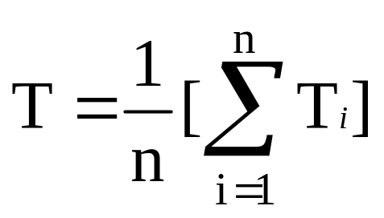
For each user, you want to have the shortest turnaround time for your job. However, as the manager of computer system, he always hopes to make the average turnaround time the shortest, which will not only effectively improve the utilization of system resources, but also make most users satisfied. The job turnaround time and the average job turnaround time should be kept as short as possible. Otherwise, it will make the waiting time of many users too long, which will cause the dissatisfaction of users, especially those with short jobs. The average turnaround time can be described as:

Slide 12
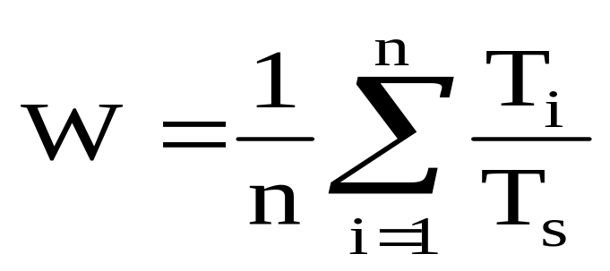
In order to further reflect the performance of scheduling and more clearly describe the specific allocation of waiting and execution time of each process in its turnaround time, weighted turnaround time is often used, that is, the ratio of the turnaround time T of the job to the time T_{s} provided by the system, that is, W = T/T_{s}. The average weighted turnaround time can be expressed as:

Slide 13
(2) high system throughput. Since throughput refers to the number of jobs completed by the system per unit of time, it is related to the average length of batch jobs. In fact, if the goal is simply to achieve high system throughput, you should choose to run as many short jobs as possible.
(3) high processor utilization. For large and medium-sized computers, CPU is very expensive, so the utilization of processor becomes a very important index to measure system performance. The scheduling method and algorithm play a very important role in the utilization of the processor. If it is only to make the processor utilization high, should choose as many computationally heavy jobs as possible to run. As can be seen from the above, there is a certain contradiction between these requirements.

Slide 14
3. The goal of a time-sharing system
(1) Fast response time.
Fast response time is an important criterion for selecting process scheduling algorithm in time-sharing system. Response time is a period of time between when a user submits a request via the keyboard and when the result is displayed on the screen.

Slide 15
(2) Equalization
Equalization refers to the speed of the system response time and the complexity of the service requested by the user.

Slide 16
4. The goal of a real-time system
(1) Guarantee of deadline.
A deadline is the time at which a task must be started or completed.

Slide 17
(2) Predictability
In real-time system, predictability is very important. For example, in a multimedia system, films or TV series should be played continuously, which provides predictability of requests. If double buffering is used in the system, it can realize the parallel processing of playing frame i and reading frame i + 1, so as to improve its real-time performance.

Slide 18
3.2 Jobs and job scheduling
In a multi-channel batch system, a job is a relatively separate task that the user submits to the system. The operator enters the jobs submitted by the user into disk storage via the corresponding input device and stores them in a backup job queue. The job scheduler then calls it from external storage into memory.

Slide 19
3.2.1 A job in a batch system
1. Job and job step
(1) Job
A job is a much broader concept than a program. It not only contains the usual program and data, but it should also be accompanied by a job specification according to which the system controls the operation of the program. In a batch system, a job is the base unit to be called into memory from external storage.

Slide 20
(2) Job Step
Typically, during job runs, each job must go through several relatively independent and interrelated sequential processing steps to get results. We call each of the processing steps a job step, each job step is interrelated, often is the output of the previous job step as the next job step input. For example, a typical job can be divided into the "compile" job step, the "link assembly" job step, and the "run" job step.

Slide 21
2. Job Control Block，JCB)
To manage and schedule jobs, in a multi-channel batch system, a job control block JCB is set for each job, which is a marker of the presence of the job in the system and holds all the information the system needs to manage and schedule jobs.

Slide 22
3. The job runs in three phases and three states
From the time a job enters the system to the end of the run, it usually goes through three stages: take in, run in, and complete. The corresponding job also has "backup state", "running state" and "complete state".
(1) Take in
The operator enters the user-submitted job onto the hard disk through some type of input , establishes a JCB for the job, and places it in the job backup queue. Accordingly, the state of the job at this time is the "backup state".

Slide 23
(2) Run in
When a job is selected by the job scheduler, the necessary resources are assigned to it, the process is established, and it is placed on the ready queue. A job is "running state" from the time it first enters the ready state until the end of its run.
(3) Complete
When the job is completed or ends early due to an abnormal situation, the job enters the completion phase, and the corresponding job state is "complete state". At this point, the "terminate job" program in the system will recover the job control block and all resources that have been allocated to the job, and output the result information of the job running into an output file.

Slide 24
3.2.2 The main task of job scheduling
The main task of job scheduling is to check whether the resources in the system can meet the requirements of jobs on resources according to the information in JCB, and according to a certain scheduling algorithm, select some jobs from the external storage backup queue to be transferred into memory, create processes for them, and allocate necessary resources. The newly created process is then placed on the ready queue for scheduling. Therefore, job Scheduling is also called Admission Scheduling. The following two decisions need to be made each time a job schedule is executed.

Slide 25
1. How many jobs are accepted
Each time a job is scheduled, how many jobs from the backup queue should be selected to move into memory depends on the Degree of Multiprogramming, that is, how many jobs to run in memory at the same time.

Slide 26
2. Which jobs are accepted
Which jobs in the backup queue should be selected to call into memory depends on the scheduling algorithm used. The simplest is the first-come-first-served scheduling algorithm, which prioritized the first job into memory. One of the more common algorithms is the short job first scheduling algorithm, which is to put the job with the shortest execution time into memory. Another commonly used scheduling algorithm is job priority-based scheduling algorithm, which is to bring the highest job priority into memory. A better algorithm is the "Highest response ratio next" scheduling algorithm. We will introduce the above algorithms in more detail later.

Slide 27
3.2.3 FCFS and SJF scheduling algorithm
1. first-come first-served（FCFS） scheduling algorithm
FCFS is the simplest scheduling algorithm, which can be used for both job scheduling and process scheduling. When using this algorithm, in job scheduling system will be carried out in accordance with the job reaches the order to scheduling, or it is a priority in the system waiting for the longest time, regardless of the length of the execution time needed for this job, select a few from the backup job queue first enter the queue assignments, to memory with them, for they allocate resources and creating process. Then put it into the ready queue.

Slide 28
2. short job first（SJF）scheduling algorithm
In practice, short jobs (processes) account for a large proportion, and in order to enable them to execute more than long jobs, a short job priority scheduling algorithm is created.
1) short job first algorithm
SJF algorithm is based on the length of the job to calculate the priority, the shorter the job, the higher the priority. The length of the job is measured by the elapsed time required for the job. SJF algorithm can be used for job scheduling and process scheduling respectively. When the short job priority scheduling algorithm is used for job scheduling, it selects several jobs with the shortest estimated running time from the externally stored job backup queue and calls them into the memory for operation first.

Slide 29
case1：There is a batch processing system that can only load two jobs in memory, the job scheduling adopts the short job first scheduling algorithm, and the process scheduling adopts the preemptive scheduling algorithm based on the priority.
Job name | arrived time | elapsed time | priority
A | 10:00 | 40 min | 5
B | 10:20 | 30 min | 3
C | 10:30 | 50 min | 4
D | 10:50 | 20 min | 6

Slide 30
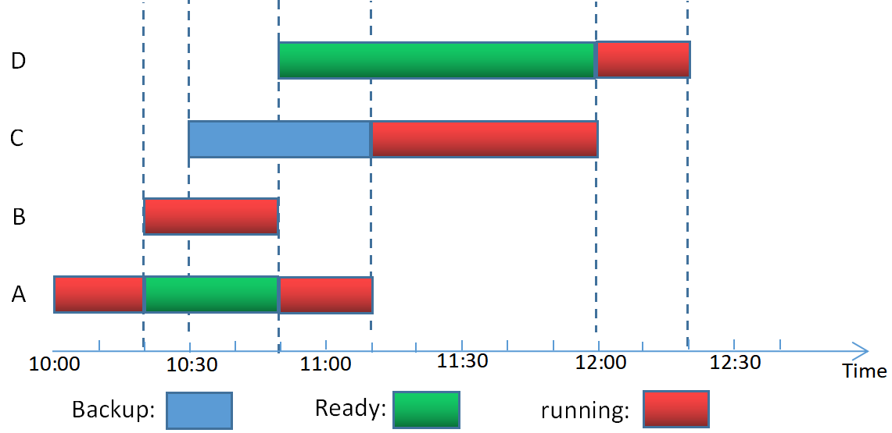
Job name | arrived time | elapsed time | priority
A | 10:00 | 40 min | 5
B | 10:20 | 30 min | 3
C | 10:30 | 50 min | 4
D | 10:50 | 20 min | 6

Slide 31
3.2.4 priority-scheduling algorithm and Highest Response Ratio Next
1. priority-scheduling algorithm，PSA
We can look at the priority of the job in this way. For the first-come-first-served scheduling algorithm, the waiting time of the job is the priority of the job. The longer the waiting time, the higher the priority. For the short-job priority scheduling algorithm, the length of the job is the priority of the job, and the shorter the time the job needs to run, the higher the priority. But neither of these priorities reflects the urgency of the task.
In the priority scheduling algorithm, the job is assigned the corresponding priority by the outside based on the urgency of the job, and the scheduling algorithm is scheduled according to the priority. This can ensure that urgent work priority.

Slide 32
2. Highest Response Ratio Next，HRRN
In batch system, FCFS algorithm only considers the waiting time of the job, but ignores the running time of the job. In contrast, SJF algorithm only considers the running time of the job and ignores the waiting time of the job. The highest-response-ratio-next scheduling algorithm is a scheduling algorithm that takes into account both the waiting time and the running time of the job, so it not only takes care of the short job, but also does not cause the waiting time of the long job to be too long, thus improving the performance of the processor scheduling.

Slide 33
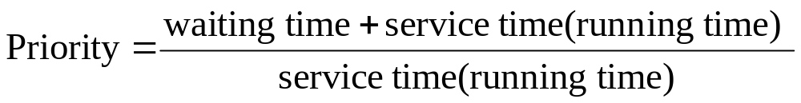
The highest-response-ratio-next algorithm introduces a dynamic priority, that is, the priority can be changed, so that it increases with the waiting time, this will make the priority of the long job in the waiting period continuously increase, wait for enough time, there is bound to be a chance to get the processor. The change rule of the priority can be described as:

Slide 34
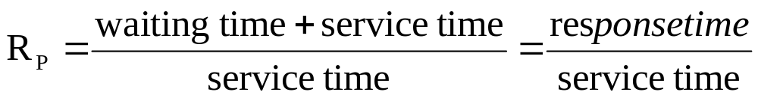
Since the sum of the wait time and service time is the response time of the system to the job, the priority is also equivalent to the response ratio R_{P}. Accordingly, priority can be expressed as:

Slide 35
3.3 Process scheduling
Process scheduling is an essential scheduling in OS. Therefore, in all three types of OS, process scheduling is configured without exception. In addition, it is also one of the processor scheduling that has the greatest impact on system performance.

Slide 36
3.3.1 The tasks and modes of process scheduling
1. Process scheduling tasks
(1) Save the field information of the processor
When scheduling, you first need to save the field information of the current process's processor, such as the program counter, the contents of multiple general registers, and so on.
(2) The process is selected by an algorithm
The scheduler, by some algorithm, selects a process from the ready queue, changes its state to the running state, and prepares to assign the processor to it.

Slide 37
(3) Assign the processor to the process
When the dispatcher assigns the processor to the process, it is necessary to load the information about the processor site in the process control block of the selected process into the corresponding registers of the processor, and then give control of the processor to the process so that it can resume running from the last breakpoint.

Slide 38
2. Modes of process scheduling
1) Nonpreemptive Mode
In this type of scheduling, once the processor is assigned to a process, it is allowed to continue running, never preempting the processor of the currently running process due to clock interruption or any other reason until the process is completed or blocked by an event.

Slide 39
2) Preemptive Mode
This type of scheduling allows the scheduler to suspend an executing process and reassign a processor assigned to that process to another process on some principle.
"Preemption" is not a kind of arbitrary behavior, must follow certain principles. The main principles are:
(1) the priority principle, that is, to allow a new process with high priority to preemption of the current process processor, that is, when a new process arrives, if its priority is higher than the priority of the executing process, the scheduler will deprive the current process of running, the processor will be assigned to the new process with high priority.

Slide 40
(2) the short process priority principle, refers to the new arrival of the short process can preempt the current long process of the processor, that is, when the new arrival of the process is significantly shorter than the executing process (still running time), the processor is allocated to the new arrival of the short process.
(3)The principle of time slice, that is, each process according to the time slice rotation run, when the process is executing a time slice used up, then stop the execution of the process and reschedule.

Slide 41
3.3.2 Round robin scheduling algorithm
Round robin(RR) scheduling algorithm is to make each process on the ready queue run only one time slice at a time. If there are n processes on the ready queue, each process gets approximately 1/n processor time each time.
1. The fundamentals of round robin
In RR method, the system arranges all ready processes into a ready queue according to the FCFS policy. The system can be set to generate an interrupt at regular intervals (such as 30 ms) to activate the process scheduler for scheduling, allocate the CPU to the queue leader process, and have it execute a time slice. When it is finished running, it assigns the processor to the new queue leader process in the ready queue and also lets it execute a time slice. In this way, all processes in the ready queue are guaranteed to obtain processor time of a time slice within a certain time period.

Slide 42
2. Process switching time
In RR scheduling algorithm, the switch should be in when to process, can be divided into two cases: (1) if a time slice is not yet finished, the running process has been completed, immediately activate the scheduler, it is removed from the ready queue, and scheduling head process of the ready queue to run, and start a new time slice. (2)The timer interrupt handler is activated when a time slice is used up. If the process has not finished running, the scheduler sends it to the end of the ready queue.

Slide 43
3. Time slice size determination
In RR algorithm, the size of time slice has great influence on the system performance. If you choose a small time slice, it will be good for a short job, because it can be completed in that time slice. However, small time slices mean that process scheduling and process context switching are frequently performed, which undoubtedly increases the overhead of the system. On the contrary, if the time slice is selected too long and each process can be completed in one time slice, RR algorithm will be reduced to FCFS algorithm, which cannot meet the needs of short jobs and interactive users. A desirable time slice size is slightly larger than the time required for a typical interaction, enabling most interactive processes to complete in a single time slice, resulting in a small response time.

Slide 44
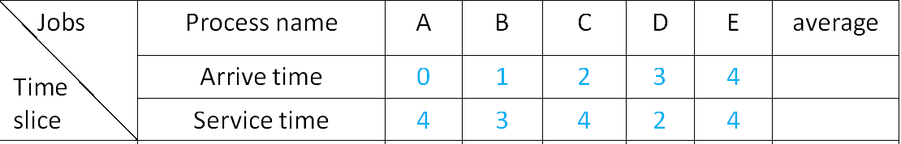
Case1:There are 5 processes in system,their arrive time and service time as follows:

Slide 45
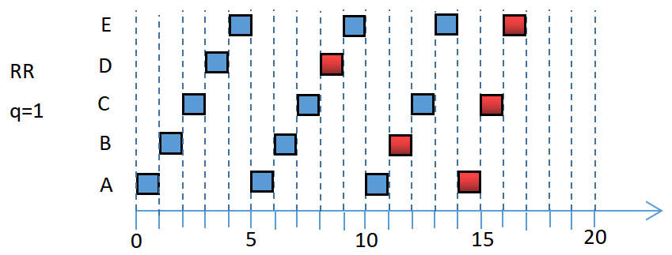

Slide 46
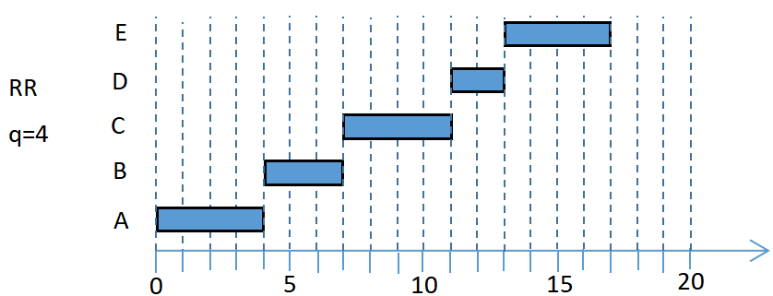

Slide 47
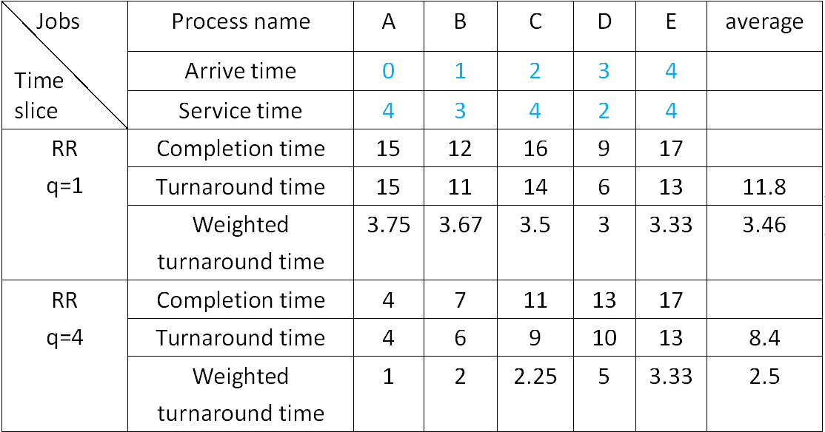
turnaround=Completion - arrive; weighted turnaround=turnaround/service

Slide 48
3.3.3 Priority scheduling algorithm
1. The type of priority scheduling algorithm
A priority process scheduling algorithm that assigns the processor to the highest priority process in the ready queue. At this time, the algorithm can be further divided into the following two types.
(1) non-preemptive priority scheduling algorithm.
The algorithm stipulates that once the processor is assigned to the process with the highest priority in the ready queue, the process will continue to execute until it is completed, or the system may reassign the processor to another process with the highest priority if the process is abandoned due to an event in the process.

Slide 49
(2) preemptive priority scheduling algorithm.
Assign the processor to the process with the highest priority for execution. But during its execution, whenever another process with a higher priority appears, the scheduler assigns the processor to the newly arrived process with the highest priority.

Slide 50
2. The type of priority
1) Static priority
The static priority is determined when the process is created and remains the same throughout the process's run.
2) Dynamic priority
Dynamic priority refers to giving a priority to a process at the beginning of its creation, and then changing its value as the process progresses or the waiting time increases, so as to obtain better scheduling performance.

Slide 51
3.3.4 Multilevel feedback queue scheduling algorithm
All the above algorithms for process scheduling have some limitations. If the process length is not specified, both the short process first and the preemptive scheduling algorithm based on the process length will be unavailable. However, the following multilevel feedback queue scheduling algorithm does not need to know the required execution time of various processes in advance, and can well meet the needs of various types of processes, so it is a better process scheduling algorithm recognized at present.

Slide 52
3.3.5 Multileved feedback(FB) queue
1. Scheduling mechanism
The scheduling mechanism of multilevel feedback queue scheduling algorithm can be described as follows:
(1) Set up multiple ready queues
Multiple ready queues are set up on the system and each queue is given a different priority.The first queue has the highest priority, the second takes second place, and the priority of the remaining queues decreases one by one. The size of the time slice that the algorithm assigns to processes in different queues also varies, and the higher the priority of the queue, the smaller the time slice.For example, the time slice of the second queue is twice as long as the time slice of the first queue... , the time slice of the i+1 queue is twice as long as the time slice of the i queue.

Slide 53
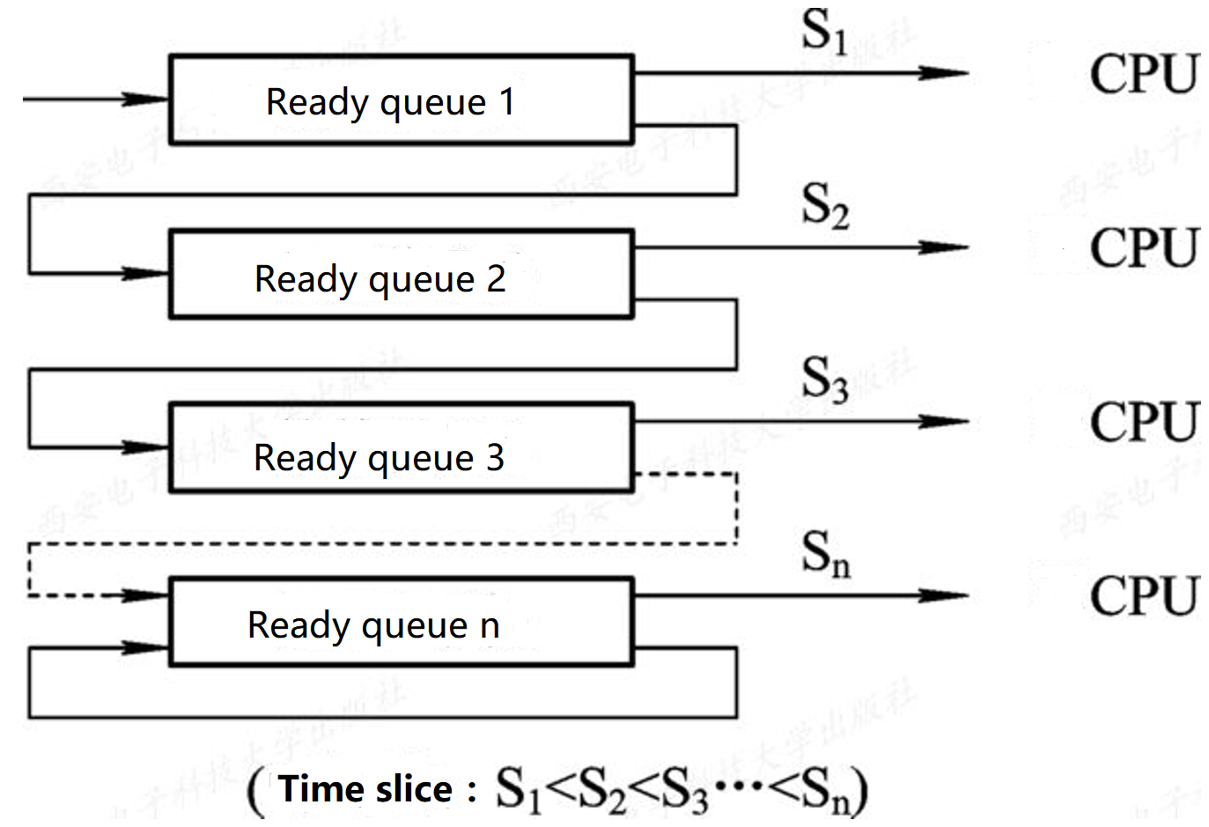

Slide 54
(2) each queue adopts FCFS algorithm.
When a new process enters memory, it is first placed at the end of the first queue and waits for scheduling according to FCFS principles. When it is the process's turn to execute, if it can complete within that time slice, the system can be deactivated. Otherwise, it is not completed at the end of a time slice, and the scheduler moves it to the end of the second queue to wait for scheduling. If it runs a time slice in the second queue and is not finished, place it in the third queue in turn... And so on. When the process is finally dropped to the NTH queue, it is run in RR mode on the nth queue.

Slide 55
(3) schedule according to queue priority.
The sche duler first schedules the processes in the highest priority queue to run, and only schedules the processes in the second queue to run when the first queue is idle. In other words, the process in the i queue is scheduled to run only if all the 1st ~ (i-1) queues are empty.

Slide 56
Case2: there are 5 processes in system, their arrive time and service time as table. if all processes are scheduled by FCFS、non-preemptive and preemptive SJF、HRRN、RR(q=1)、Multileved feedback(FB) queue（time slice of the iths queue is 2^{i-1} ）、preemptive multileved feedback(FB) queue（time slice of the iths queue is 2^{i-1} ）,please give out completion time、turnaround time、weighted turnaround time、the average turnaround time、the average weighted turnaround time.
Process | Arrive time | Service time
A | 0 | 3
B | 2 | 6
C | 4 | 4
D | 6 | 5
E | 8 | 2

Slide 57
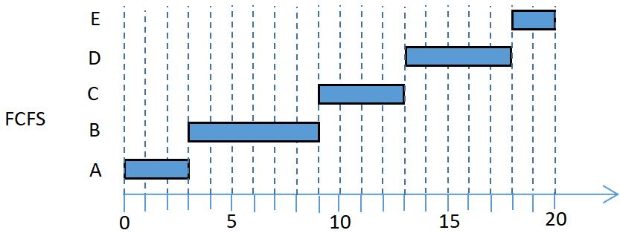
Process | Arrive time | Service time
A | 0 | 3
B | 2 | 6
C | 4 | 4
D | 6 | 5
E | 8 | 2
 | Process | A | B | C | D | E | ave
FCFS | completion | 3 | 9 | 13 | 18 | 20
 | turnaround | 3 | 7 | 9 | 12 | 12 | 8.6
 | weighted turnaround | 1.00 | 1.17 | 2.25 | 2.40 | 6.00 | 2.56

Slide 58
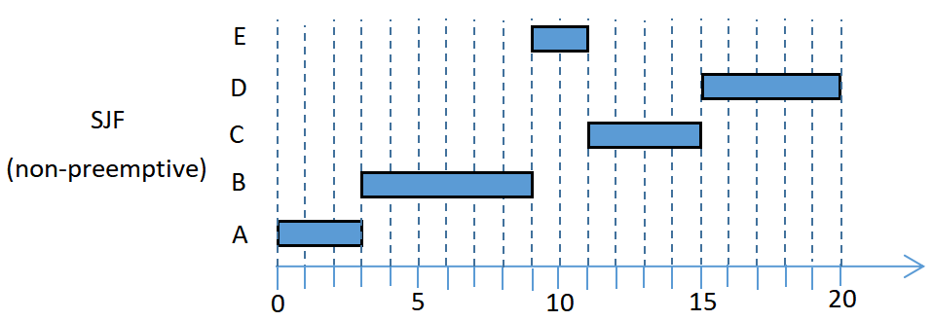
Process | Arrive time | Service time
A | 0 | 3
B | 2 | 6
C | 4 | 4
D | 6 | 5
E | 8 | 2
Process | A | B | C | D | E | ave
completion | 3 | 9 | 15 | 20 | 11
turnaround | 3 | 7 | 11 | 14 | 3 | 7.6
weighted turnaround | 1.00 | 1.17 | 2.75 | 2.80 | 1.50 | 1.84

Slide 59
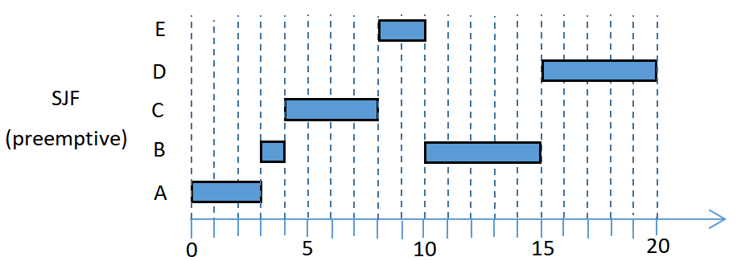
Process | Arrive time | Service time
A | 0 | 3
B | 2 | 6
C | 4 | 4
D | 6 | 5
E | 8 | 2
Process | A | B | C | D | E | ave
completion | 3 | 15 | 8 | 20 | 10
turnaround | 3 | 13 | 4 | 14 | 2 | 7.2
weighted turnaround | 1.00 | 2.16 | 1.00 | 2.80 | 1.00 | 1.59

Slide 60
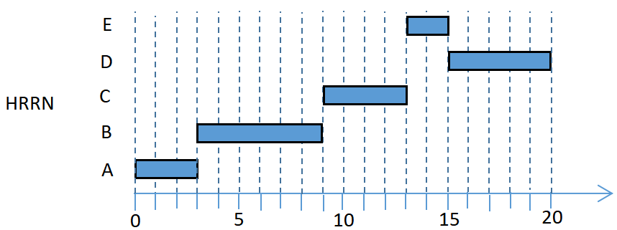
Process | Arrive time | Service time
A | 0 | 3
B | 2 | 6
C | 4 | 4
D | 6 | 5
E | 8 | 2
Process | A | B | C | D | E | ave
completion | 3 | 9 | 13 | 20 | 15
turnaround | 3 | 7 | 9 | 14 | 7 | 8
weighted turnaround | 1.00 | 1.17 | 2.25 | 2.80 | 3.50 | 2.14

Slide 61
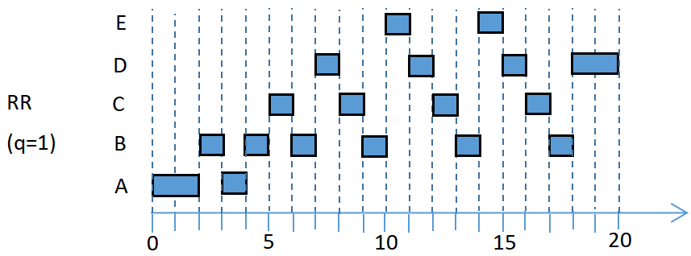
Process | Arrive time | Service time
A | 0 | 3
B | 2 | 6
C | 4 | 4
D | 6 | 5
E | 8 | 2
Process | A | B | C | D | E | ave
completion | 4 | 18 | 17 | 20 | 15
turnaround | 4 | 16 | 13 | 14 | 7 | 10.8
weighted turnaround | 1.33 | 2.67 | 3.25 | 2.80 | 3.50 | 2.71

Slide 62
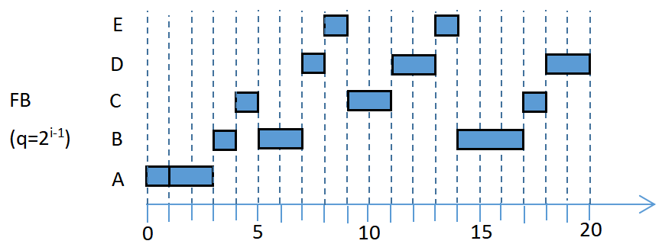
Process | Arrive time | Service time
A | 0 | 3
B | 2 | 6
C | 4 | 4
D | 6 | 5
E | 8 | 2
Process | A | B | C | D | E | ave
completion | 3 | 17 | 18 | 20 | 14
turnaround | 3 | 15 | 14 | 14 | 6 | 10.4
weighted turnaround | 1.00 | 2.50 | 3.50 | 2.80 | 3.00 | 2.56

Slide 63
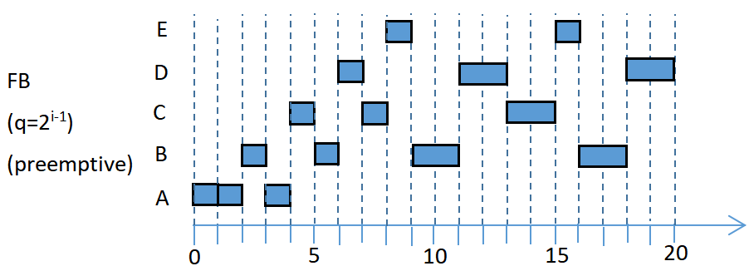
Process | Arrive time | Service time
A | 0 | 3
B | 2 | 6
C | 4 | 4
D | 6 | 5
E | 8 | 2
Process | A | B | C | D | E | ave
completion | 4 | 18 | 15 | 20 | 16
turnaround | 4 | 16 | 11 | 14 | 8 | 10.6
weighted turnaround | 1.33 | 2.67 | 2.75 | 2.80 | 4.00 | 2.87

